Slide 1
Topic 7: CPU Scheduling

Slide 2
Process Scheduling
Basic Concepts
Scheduling Criteria
Scheduling Algorithms
Algorithm Evaluation

Slide 3
Objectives
To introduce CPU scheduling, which is the basis for multiprogrammed operating systems
To describe various CPU-Scheduling Algorithms
To discuss evaluation criteria for selecting a CPU-scheduling algorithm for a particular system
To examine the scheduling algorithms of several operating systems

Slide 4
Basic Concepts
In a single-processor system, only one process can run at a time.
The objective of multiprogramming is to have some process running at all times, to maximize CPU utilization.
CPU & I/O Burst Cycle ➔ Process execution consists of a cycle of CPU execution and I/O wait.
Processes alternate between these two states.
Process execution begins with a CPU burst.
CPU burst followed by I/O burst
The final CPU burst ends with a system request to terminate execution.
CPU burst distribution is of main concern.

Slide 5
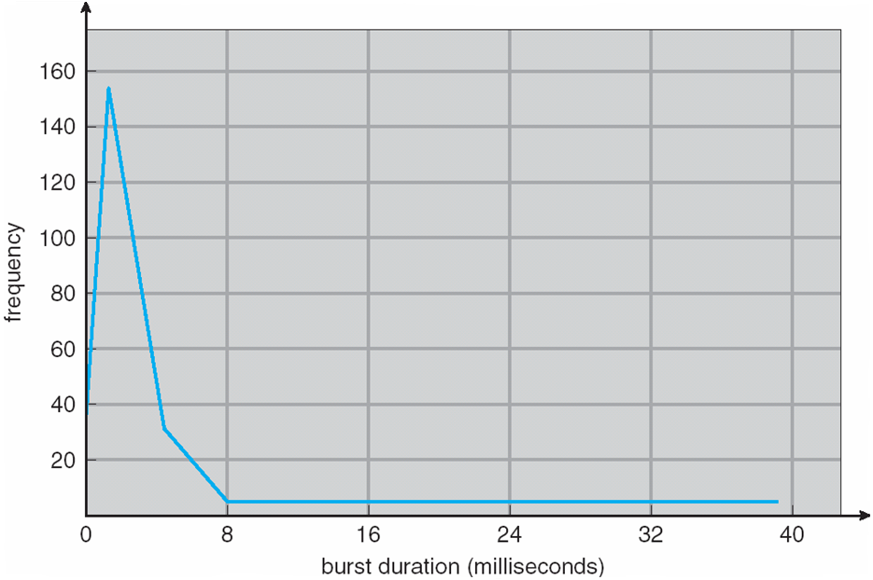
Histogram of CPU-burst Times
The curve is generally characterized by a large number of short CPU bursts and a small number of long CPU bursts.
An I/O-bound program typically has many short CPU bursts.
A CPU-bound program might have a few long CPU bursts.
This distribution can be important in the selection of an appropriate CPU-scheduling algorithm.

Slide 6
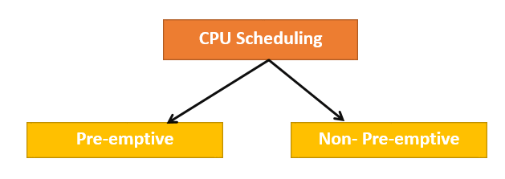
CPU Scheduler
When the CPU becomes idle, the operating system must select one of the processes in the ready queue to be executed.
The selection process is carried out by the short-term scheduler, or CPU scheduler.
The scheduler selects a process from the processes in memory (Ready Queue) that are ready to execute and allocates the CPU to that process.
Ready Queue may be ordered in various ways.
Ready Queue is not necessarily a first-in, first-out (FIFO) queue.
Ready Queue can be implemented as a FIFO queue, a priority queue, a tree, or simply an unordered linked list.
All the processes in the ready queue are lined up waiting for a chance to run on the CPU.
The records in the queues are generally processed control blocks (PCBs) of the processes.

Slide 7
Preemptive Scheduling
CPU-scheduling decisions may take place under the following four circumstances:
1. Switches from running to waiting state
2. Switches from running to ready state
3. Switches from waiting to ready
Terminates
For situations 1 and 4, there is no choice in terms of scheduling.
A new process must be selected for execution.
When scheduling takes place only under circumstances 1 and 4, we say that the scheduling scheme is nonpreemptive or cooperative. Otherwise, it is preemptive.
Nonpreemptive scheduling:
When the CPU has been allocated to a process,
The process keeps the CPU until it releases the CPU either by Terminating or switching to the waiting state.
All other scheduling is preemptive
Consider access to shared data
Consider preemption while in kernel mode
Consider interrupts occurring during crucial OS activities

Slide 8
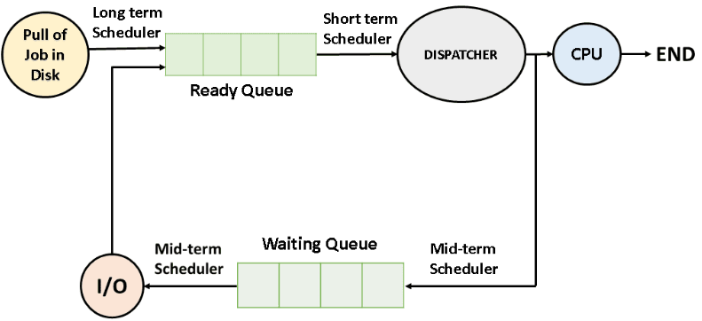
Dispatcher
Another component involved in the CPU-scheduling function is the dispatcher
The dispatcher is the module that gives control of the CPU to the process selected by the short-term scheduler.
This function involves the following:
switching context
switching to user mode
jumping to the proper location in the user program to restart that program
The dispatcher should be as fast as possible since it is invoked during every process switch.
The time it takes for the dispatcher to stop one process and start another running is known as the dispatch latency.

Slide 9
Scheduling Criteria
Different CPU scheduling algorithms have different properties, and the choice of a particular algorithm may favor one class of processes over another.
In choosing which algorithm to use must consider the properties of the various algorithms.
Many criteria have been suggested for comparing CPU scheduling algorithms.
The criteria include the following:
CPU utilization ➔ Max ➔ (It is to keep the CPU as busy as possible)
Throughput ➔ Max ➔ (It is the number of processes that are completed per time unit)
Turnaround Time ➔ Min ➔ (It is an interval from the time of submission of a process to the time of completion)
Turnaround time is the sum of the periods spent waiting to get into memory, waiting in the ready queue, executing on the CPU, and doing I/O.
Waiting Time ➔ Min ➔ (It affects only the amount of time that a process spends waiting in the ready queue)
Waiting time is the sum of the periods spent waiting in the ready queue
Response Time ➔ Min ➔ (It is the time from the submission of a request until the first response is produced)
Response Time is the time it takes to start responding, not the time it takes to output the response.
Optimization Criteria

Slide 10
Scheduling Algorithms
CPU scheduling deals with the problem of deciding which of the processes in the ready queue is to be allocated to the CPU.
There are many different CPU-scheduling algorithms.
First-Come, First-Served Scheduling
Shortest-Job-First Scheduling
Priority Scheduling
Round-Robin Scheduling
Multilevel Queue Scheduling
Multilevel Feedback Queue Scheduling

Slide 11
First-Come, First-Served (FCFS) Scheduling
It is the simplest CPU-scheduling algorithm.
The process that requests the CPU first is allocated to the CPU first.
The FCFS policy is easily managed with a FIFO queue.
When a process enters the ready queue, its PCB is linked onto the tail of the queue.
When the CPU is free, it is allocated to the process at the head of the queue.
The running process is then removed from the queue.
The average waiting time is often quite long.
Process Burst Time
P₁ 24
P₂ 3
P₃ 3
Suppose that the processes arrive in the order: P₁ , P₂ , P₃ The Gantt Chart for the schedule is:
Waiting time for P₁ = 0; P₂ = 24; P₃ = 27
Average waiting time: (0 + 24 + 27)/3 = 17 milliseconds
P₁
P₂
P₃
0
24
27
30

Slide 12
FCFS Scheduling (Cont.)
Suppose that the processes arrive in the order:
P₂ ➔ P₃ ➔ P₁
The Gantt chart for the schedule is:
Waiting time for
P₁ = 6
P₂ = 0
P₃ = 3
Average waiting time: (6 + 0 + 3)/3 = 3 milliseconds ➔ Much better than previous case
There is a convoy effect as all the other processes wait for the one big process to get off the CPU.
This effect results in lower CPU and device utilization than might be possible if the shorter processes were allowed to go first.
The FCFS scheduling algorithm is nonpreemptive.
P₂
P₃
P₁
0
3
6
30

Slide 13
Shortest-Job-First (SJF) Scheduling
This algorithm associate with each process the length of the process’s next CPU burst.
Use these lengths to schedule the process with the shortest time
When the CPU is available, it is assigned to the process that has the smallest next CPU burst.
If the next CPU bursts of two processes are the same, FCFS scheduling is used to break the tie.
The appropriate term for this scheduling method would be the shortest-next CPU-burst algorithm.
Because scheduling depends on the length of the next CPU burst of a process, rather than its total length.
SJF is optimal – gives minimum average waiting time for a given set of processes
The difficulty is knowing the length of the next CPU request
Could ask the user

Slide 14
Example of SJF
ProcessArriva l Time Burst Time
P₁ 0.0 6
P₂ 2.0 8
P₃ 4.0 7
P₄ 5.0 3
SJF scheduling Gantt chart
The waiting time is
3 milliseconds for process P1,
16 milliseconds for process P2,
9 milliseconds for process P3,
0 milliseconds for process P4.
Average waiting time = (3 + 16 + 9 + 0) / 4 = 7
If we were using the FCFS scheduling scheme, the average waiting time would be 10.25 milliseconds
P₄
P₁
P₃
P₂
0
3
9
16
24
Moving a short process before a long process:
Leads to decreases the waiting time of the short process more than it increases the waiting time of the long process.
?
Notes:
10.25

Slide 15
Determining Length of Next CPU Burst
We may not know the length of the next CPU burst.
We may be able to predict its value.
We expect that the next CPU burst will be similar in length to the previous ones.
By computing an approximation of the length of the next CPU burst.
We can pick the process with the shortest predicted CPU burst.
The next CPU burst is generally predicted as an exponential average of the measured lengths of previous CPU bursts.
Can only estimate the length ➔ should be similar to the previous one
Then pick process with shortest predicted next CPU burst
Can be done by using the length of previous CPU bursts, using exponential averaging
Commonly, α set to ½
Preemptive version called shortest-remaining-time-first

Slide 16
Prediction of the Length of the Next CPU Burst

Slide 17
Examples of Exponential Averaging
α =0
τ_{n+1} = τ_{n}
Recent history does not count
α =1
τ_{n+1} = α t_{n}
Only the actual last CPU burst counts
If we expand the formula, we get:
τ_{n+1} = α t_{n}+(1 - α)α t_{n} -1 + …
+(1 - α )^{j} α t_{n} _{-j} + …
+(1 - α )^{n +1} τ₀
Since both α and (1 - α) are less than or equal to 1, each successive term has less weight than its predecessor

Slide 18
Shortest-remaining-time-first
The SJF algorithm can be either preemptive or nonpreemptive.
The choice arises when a new process arrives at the ready queue while a previous process is still executing.
The next CPU burst of the newly arrived process may be shorter.
Than what is left of the currently executing process.
A preemptive SJF algorithm will preempt the currently executing process, whereas a nonpreemptive SJF algorithm will allow the currently running process to finish its CPU burst.
Preemptive SJF scheduling is sometimes called shortest-remaining-time-first scheduling.

Slide 19
Example of Shortest-remaining-time-first
Now we add the concepts of varying arrival times and preemption to the analysis
ProcessA arri Arrival TimeT Burst Time
P₁ 0 8
P₂ 1 4
P₃ 2 9
P₄ 3 5
If the processes arrive at the ready queue at the times shown and need the indicated burst times, then the resulting preemptive SJF schedule is as depicted in the following Gantt chart:
Process P1 is started at time 0, since it is the only process in the queue. Process P2 arrives at time 1. The remaining time for process P1 (7 milliseconds) is larger than the time required by process P2 (4 milliseconds), so process P1 is preempted, and process P2 is scheduled.
Average waiting time ➔ [(10-1)+(1-1)+(17-2)+(5-3)]/4 = 26/4 = 6.5 milliseconds.
Nonpreemptive SJF scheduling would result in an average waiting time of 7.5 milliseconds.
P₁
P₂
P₄
P₁
P₃
0
1
5
10
17
26

Slide 20
Priority Scheduling
The SJF algorithm is a special case of the general priority-scheduling algorithm.
A priority number (integer) is associated with each process
The CPU is allocated to the process with the highest priority (smallest integer ➔ highest priority)
Priority scheduling can be either preemptive or nonpreemptive
Equal-priority processes are scheduled in FCFS order.
An SJF algorithm is simply a priority algorithm where the priority (p) is the inverse of the (predicted) next CPU burst.
The larger the CPU burst, the lower the priority, and vice versa.
Problem ➔ Indefinite blocking or Starvation ➔ Low priority processes may never execute.
Solution ➔ Aging ➔ Gradually increasing the priority of processes that wait in the system for a long time.
Priorities can be defined either internally or externally.
Internally priorities defined priorities use some measurable quantity or quantities to compute the priority of a process.
For example, time limits, memory requirements, the number of open files, and the ratio of average I/O burst to average CPU burst have been used in computing priorities.
External priorities are set by criteria outside the operating system.
For example, the importance of the process, the type and amount of funds being paid for computer use, the department sponsoring the work, and other, often political, factors.

Slide 21
Example of Priority Scheduling
Process Burst Time Priority
P₁ 10 3
P₂ 1 1
P₃ 2 4
P₄ 1 5
P₅ 5 2
Priority scheduling Gantt Chart
The waiting time is
6 milliseconds for process P1,
0 milliseconds for process P2,
16 milliseconds for process P3,
18 milliseconds for process P4
1 milliseconds for process P5.
Average waiting time = [6+0+16+18+1] = 41/5 = 8.2 milliseconds.
P₂
P₅
P₁
P₃
P₄
0
1
6
16
18
19

Slide 22
Round Robin (RR)
The round-robin (RR) scheduling algorithm is designed especially for timesharing systems.
It is similar to FCFS scheduling, but preemption is added to enable the system to switch between processes .
A small unit of time, called a time quantum or time slice, is defined.
A time quantum is generally from 10 to 100 milliseconds in length.
The ready queue is treated as a circular queue.
New processes are added to the tail of the ready queue.
The CPU scheduler goes around the ready queue, allocating the CPU to each process for a time interval of up to 1 time quantum.
The CPU scheduler picks the first process from the ready queue, sets a timer to interrupt after 1 time quantum, and dispatches the process.
Each process gets a small unit of CPU time (time quantum q), usually 10-100 milliseconds.
After this time has elapsed, the process is preempted and added to the end of the ready queue.
If there are n processes in the ready queue and the time quantum is q, then each process gets 1/n of the CPU time in chunks of at most q time units at once.
No process waits more than (n-1)q time units.
Timer interrupts every quantum to schedule next process
Performance
q large ➔ FIFO
q small ➔ q must be large with respect to context switch, otherwise overhead is too high

Slide 23
Example of RR with Time Quantum = 4
Process Burst Time
P₁ 24
P₂ 3
P₃ 3
The Gantt chart is:
Typically, higher average turnaround than SJF, but better response
q should be large compared to context switch time
q usually 10ms to 100ms, context switch < 10 microSeconds.
Let’s calculate the average waiting time for this schedule.
P1 waits for 6 milliseconds (10 - 4).
P2 waits for 4 milliseconds
P3 waits for 7 milliseconds.
Thus, the average waiting time is 17/3 = 5.66 milliseconds.
P₁
P₂
P₃
P₁
P₁
P₁
P₁
P₁
0
4
7
10
14
18
22
26
30

